Slide 1
Lecture 13:
Segmentation and Attention

Slide 2
Administrative
Assignment 3 due tonight!
We are reading your milestones

Slide 3
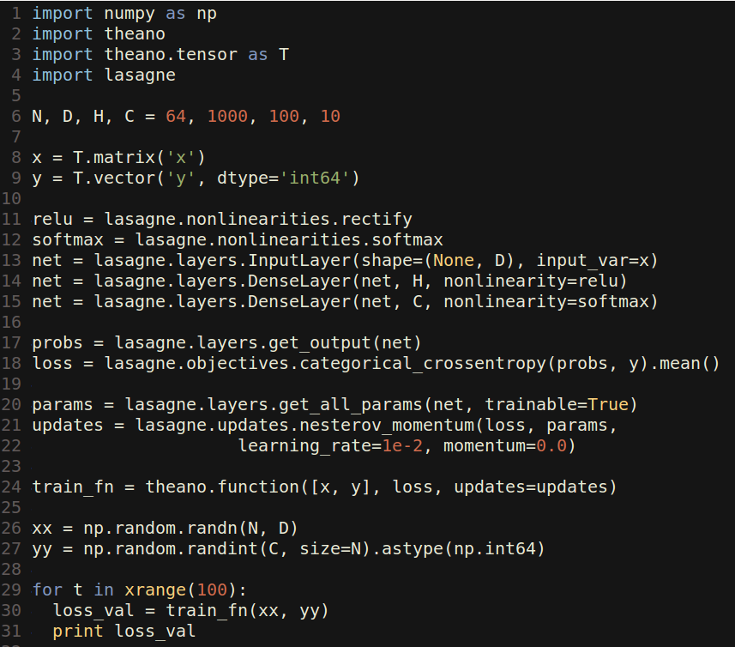
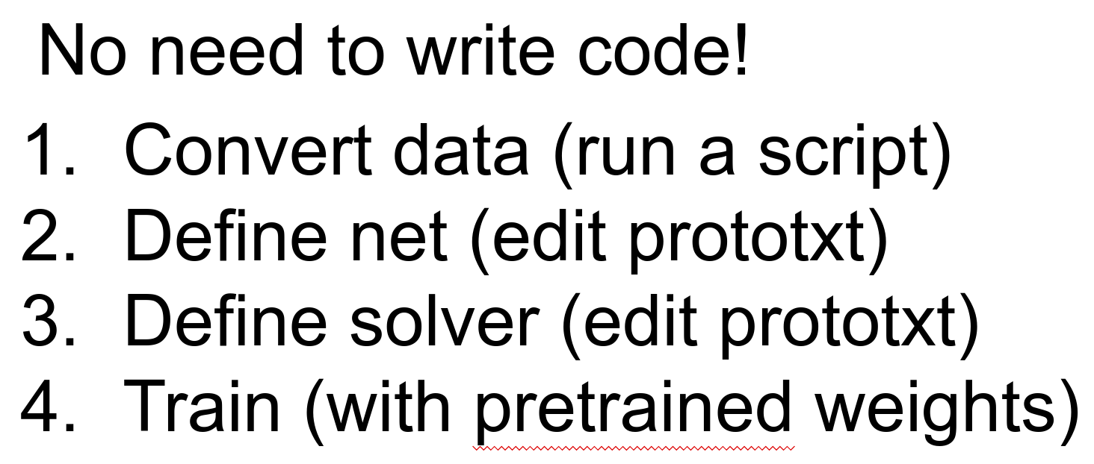
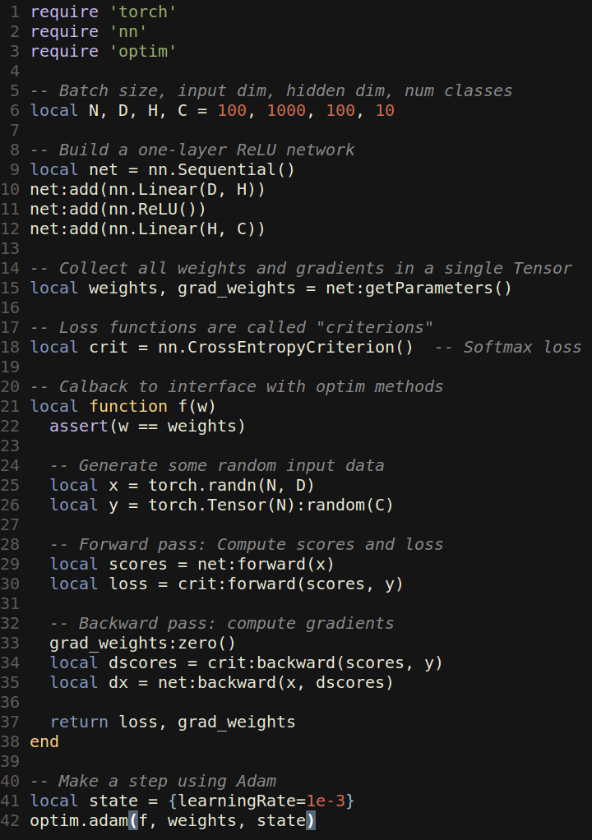
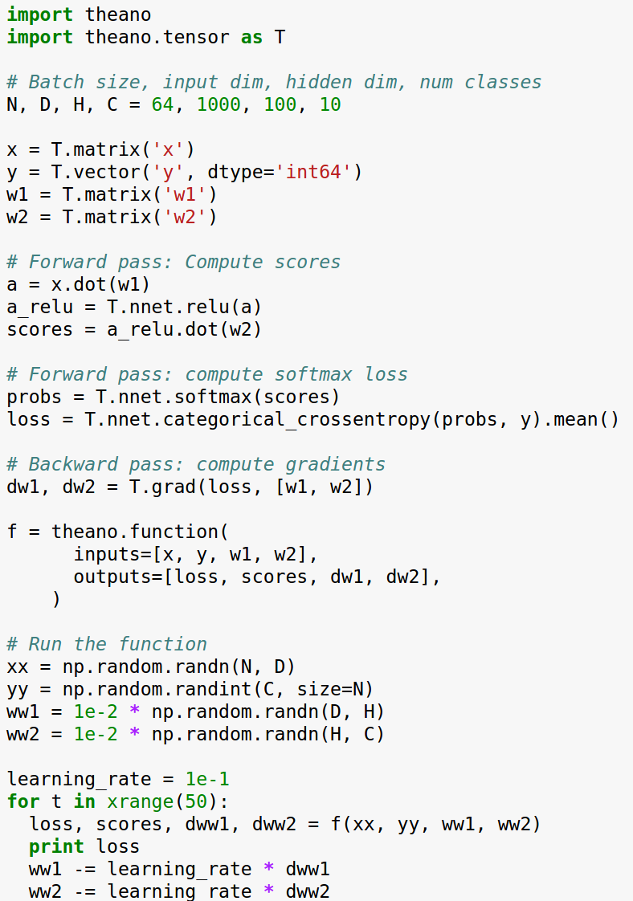
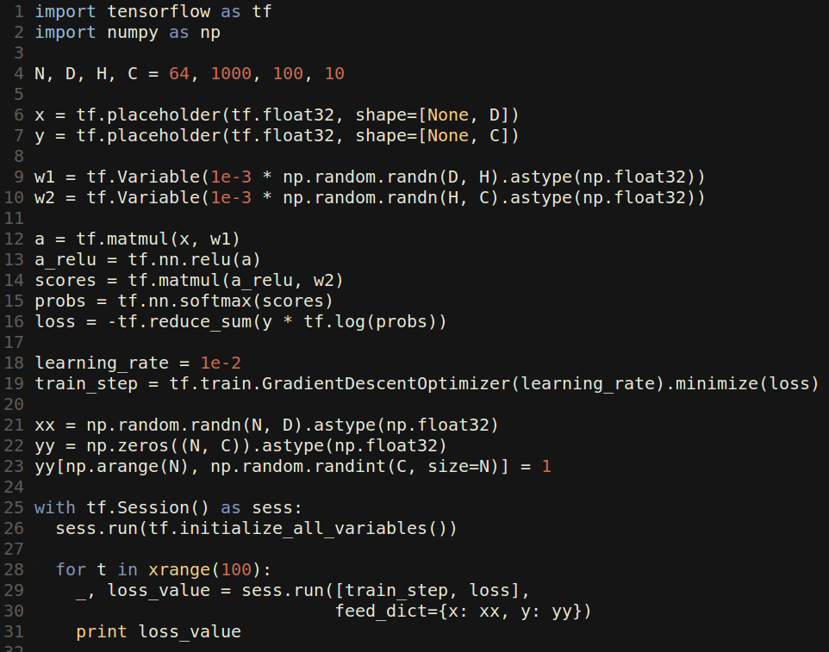
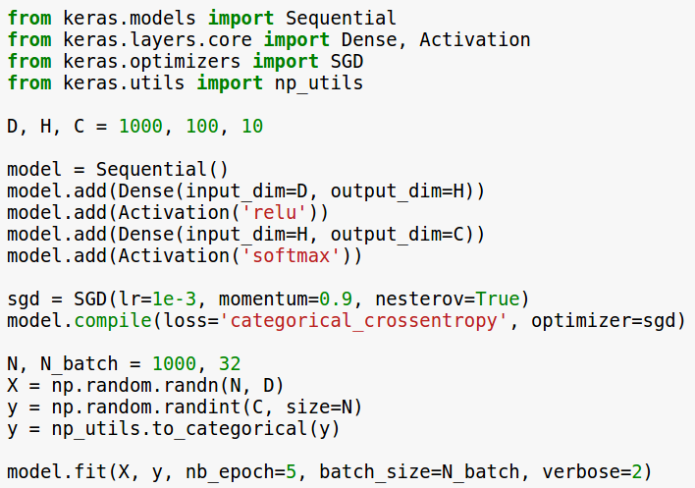
Last time: Software Packages
Lasagne
Caffe
Torch
Theano
TensorFlow
Keras

Slide 4
Today
Segmentation
Semantic Segmentation
Instance Segmentation
(Soft) Attention
Discrete locations
Continuous locations (Spatial Transformers)

Slide 5
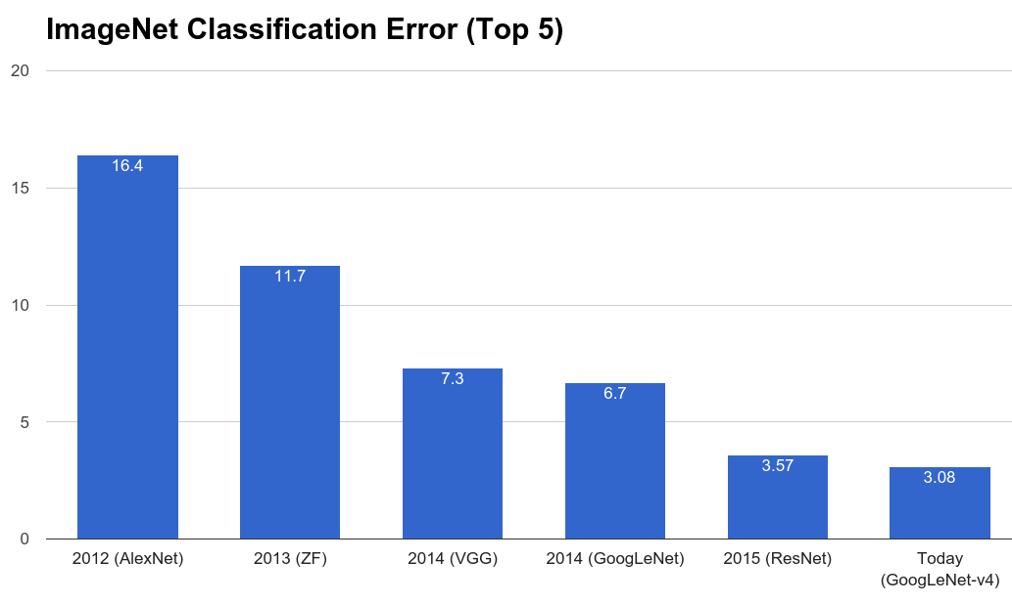
But first….

Slide 6
But first….
New ImageNet Record today!
Szegedy et al, Inception-v4, Inception-ResNet and the Impact of Residual Connections on Learning, arXiv 2016

Slide 7
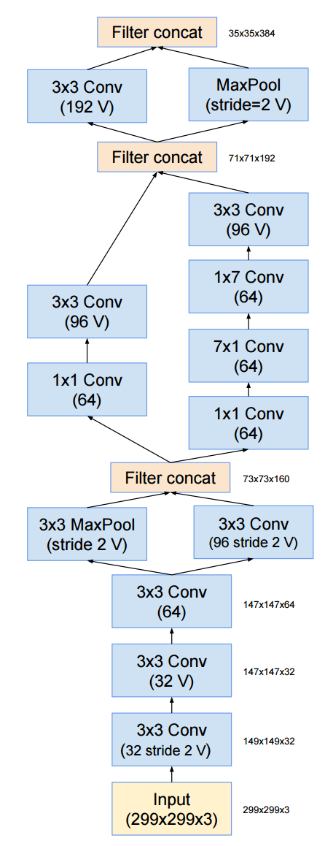
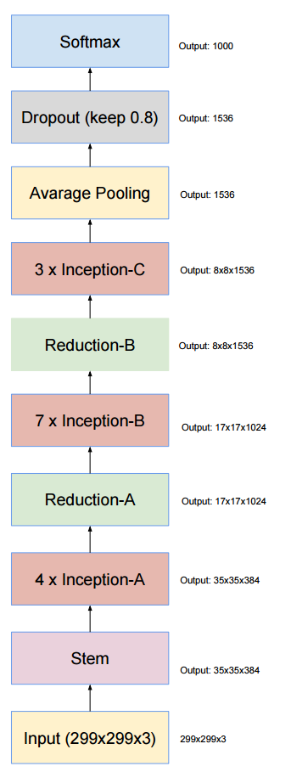
Inception-v4
1x7, 7x1 filters
Strided convolution AND max pooling
V = Valid convolutions (no padding)
9 layers
Szegedy et al, Inception-v4, Inception-ResNet and the Impact of Residual Connections on Learning, arXiv 2016

Slide 8
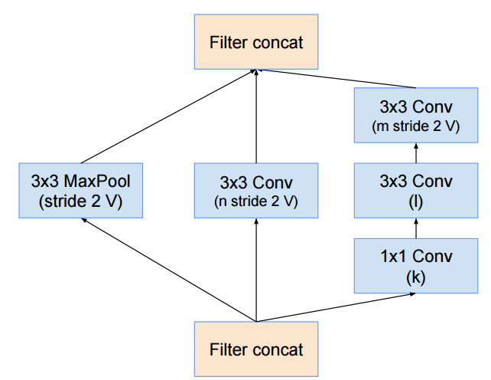
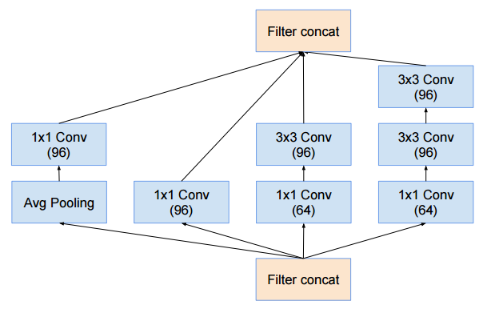
Inception-v4
3 layers
x4
4 x 3 layers
9 layers
Szegedy et al, Inception-v4, Inception-ResNet and the Impact of Residual Connections on Learning, arXiv 2016

Slide 9
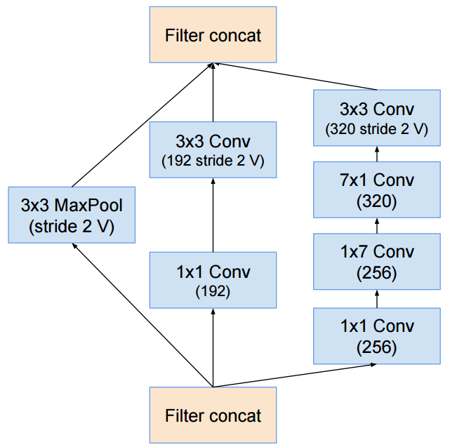
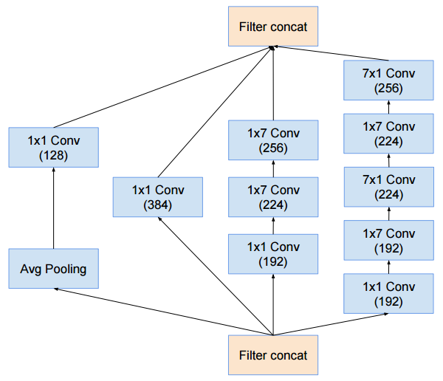
Inception-v4
4 layers
5 x 7 layers
x7
3 layers
4 x 3 layers
9 layers
Szegedy et al, Inception-v4, Inception-ResNet and the Impact of Residual Connections on Learning, arXiv 2016

Slide 10
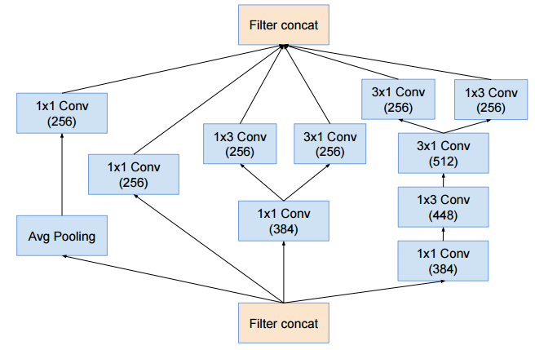
Inception-v4
x3
3 x 4 layers
4 layers
5 x 7 layers
75 layers
3 layers
4 x 3 layers
9 layers
Szegedy et al, Inception-v4, Inception-ResNet and the Impact of Residual Connections on Learning, arXiv 2016

Slide 11
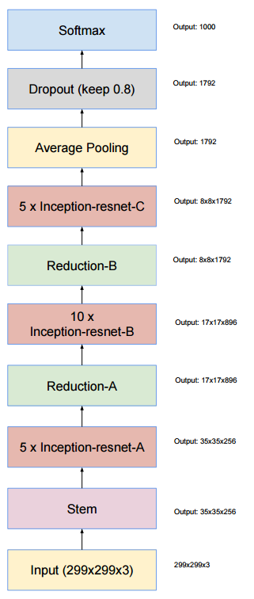
Inception-ResNet-v2
9 layers

Slide 12
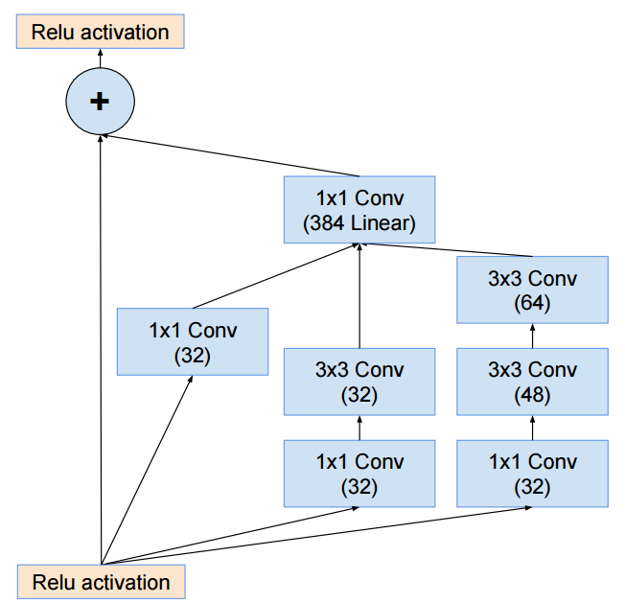
Inception-ResNet-v2
3 layers
x7
5 x 4 layers
9 layers

Slide 13
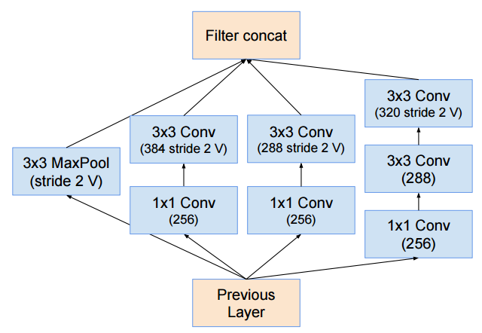
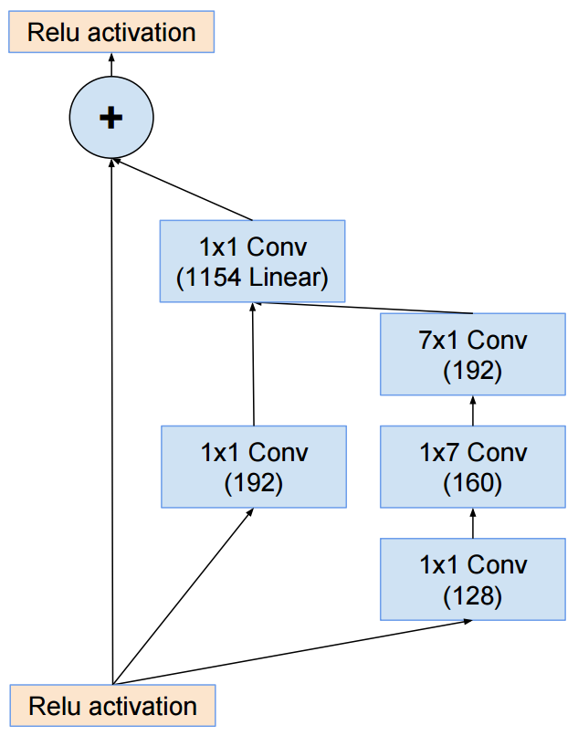
Inception-ResNet-v2
3 layers
10 x 4 layers
x10
3 layers
5 x 4 layers
9 layers

Slide 14

Inception-ResNet-v2
5 x 4 layers
x 5
3 layers
75 layers
10 x 4 layers
3 layers
5 x 3 layers
9 layers

Slide 15
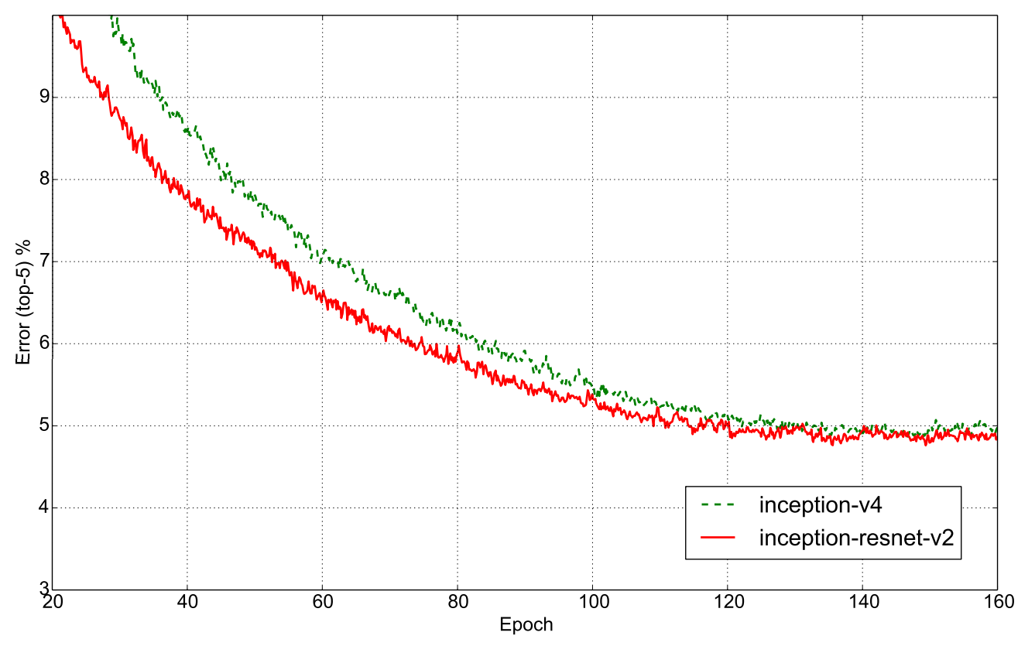
Inception-ResNet-v2
Residual and non-residual converge to similar value, but residual learns faster

Slide 16
Today
Segmentation
Semantic Segmentation
Instance Segmentation
(Soft) Attention
Discrete locations
Continuous locations (Spatial Transformers)

Slide 17
Segmentation

Slide 18
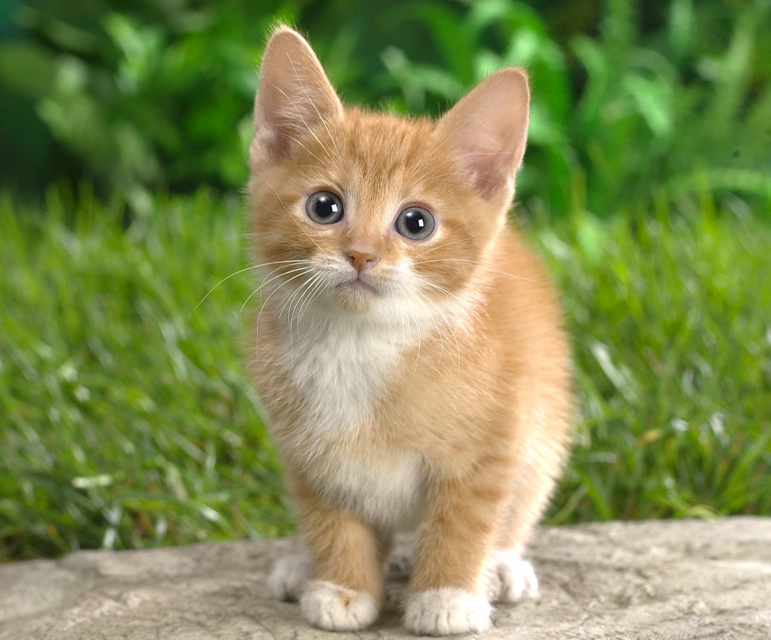
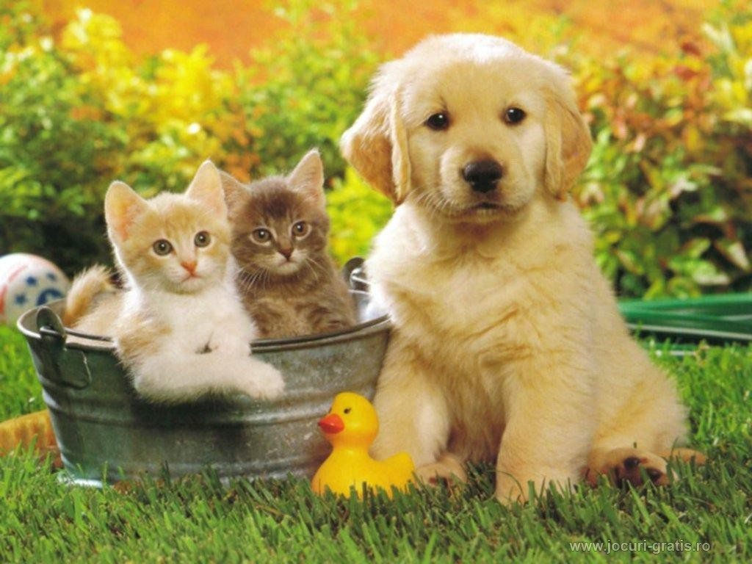
Computer Vision Tasks
Classification
Classification + Localization
Object Detection
Segmentation
CAT
CAT
CAT, DOG, DUCK
CAT, DOG, DUCK
Single object
Multiple objects
‹#›

Slide 19
Computer Vision Tasks
Classification
Classification + Localization
Object Detection
Segmentation
Lecture 8
‹#›

Slide 20
Computer Vision Tasks
Classification
Classification + Localization
Object Detection
Segmentation
Today
‹#›

Slide 21
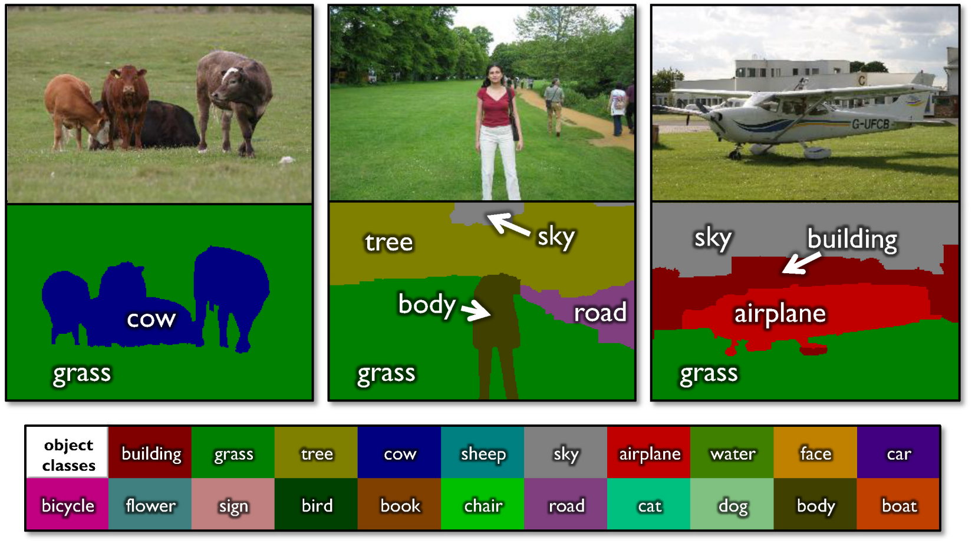
Semantic Segmentation
Label every pixel!
Don’t differentiate instances (cows)
Classic computer vision problem
Figure credit: Shotton et al, “TextonBoost for Image Understanding: Multi-Class Object Recognition and Segmentation by Jointly Modeling Texture, Layout, and Context”, IJCV 2007

Slide 22
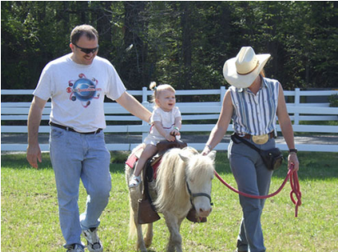
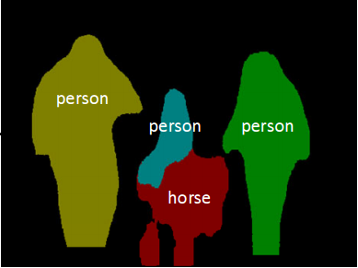
Instance Segmentation
Detect instances, give category, label pixels
“simultaneous detection and segmentation” (SDS)
Lots of recent work (MS-COCO)
Figure credit: Dai et al, “Instance-aware Semantic Segmentation via Multi-task Network Cascades”, arXiv 2015

Slide 23
Semantic Segmentation

Slide 24
Semantic Segmentation

Slide 25
Semantic Segmentation
Extract patch

Slide 26
Semantic Segmentation
Extract patch
Run through a CNN
CNN

Slide 27
Semantic Segmentation
Extract patch
Run through a CNN
Classify center pixel
CNN
COW

Slide 28
Semantic Segmentation
Extract patch
Run through a CNN
Classify center pixel
CNN
COW
Repeat for every pixel

Slide 29
Semantic Segmentation
Run “fully convolutional” network to get all pixels at once
Smaller output due to pooling
CNN

Slide 30
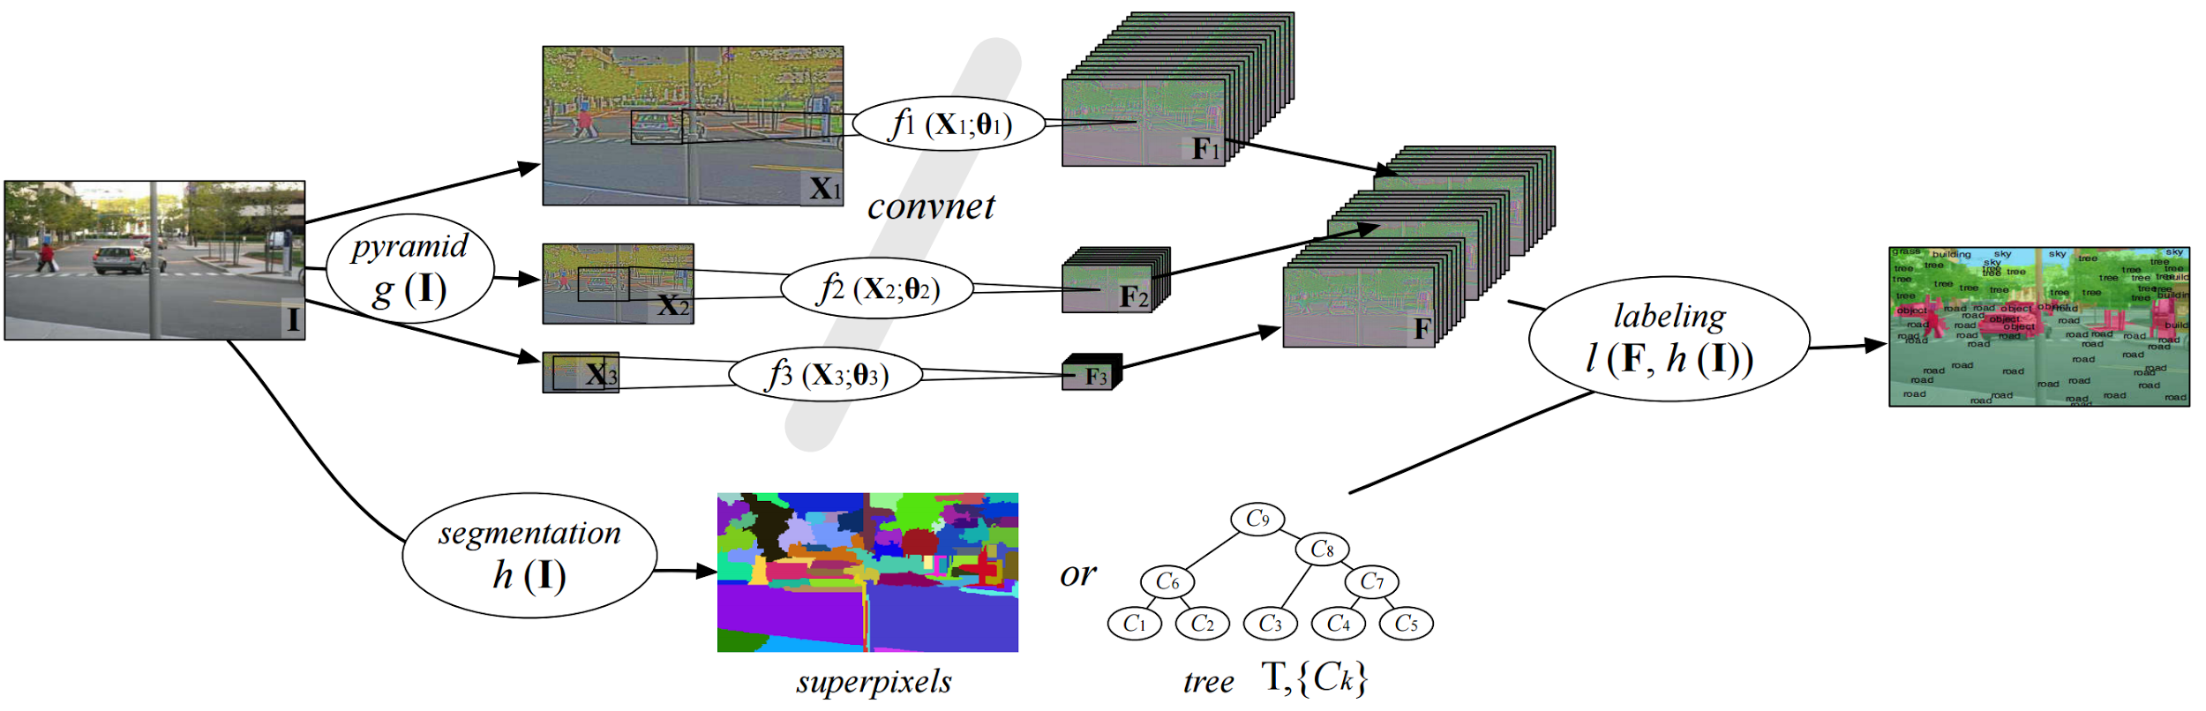
Semantic Segmentation: Multi-Scale
Farabet et al, “Learning Hierarchical Features for Scene Labeling,” TPAMI 2013

Slide 31
Semantic Segmentation: Multi-Scale
Resize image to multiple scales
Farabet et al, “Learning Hierarchical Features for Scene Labeling,” TPAMI 2013

Slide 32
Semantic Segmentation: Multi-Scale
Resize image to multiple scales
Run one CNN per scale
Farabet et al, “Learning Hierarchical Features for Scene Labeling,” TPAMI 2013

Slide 33
Semantic Segmentation: Multi-Scale
Resize image to multiple scales
Run one CNN per scale
Upscale outputs and concatenate
Farabet et al, “Learning Hierarchical Features for Scene Labeling,” TPAMI 2013

Slide 34
Semantic Segmentation: Multi-Scale
Resize image to multiple scales
Run one CNN per scale
Upscale outputs and concatenate
External “bottom-up” segmentation
Farabet et al, “Learning Hierarchical Features for Scene Labeling,” TPAMI 2013

Slide 35
Semantic Segmentation: Multi-Scale
Resize image to multiple scales
Run one CNN per scale
Upscale outputs and concatenate
Combine everything for final outputs
External “bottom-up” segmentation
Farabet et al, “Learning Hierarchical Features for Scene Labeling,” TPAMI 2013

Slide 36
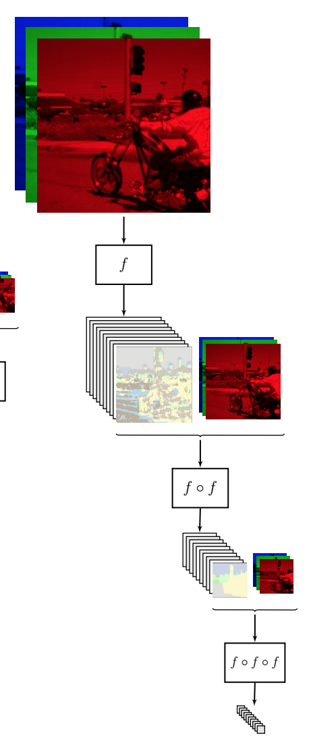
Semantic Segmentation: Refinement
Apply CNN once to get labels
Pinheiro and Collobert, “Recurrent Convolutional Neural Networks for Scene Labeling”, ICML 2014

Slide 37
Semantic Segmentation: Refinement
Apply CNN once to get labels
Apply AGAIN to refine labels
Pinheiro and Collobert, “Recurrent Convolutional Neural Networks for Scene Labeling”, ICML 2014

Slide 38
Semantic Segmentation: Refinement
Apply CNN once to get labels
Apply AGAIN to refine labels
And again!
Pinheiro and Collobert, “Recurrent Convolutional Neural Networks for Scene Labeling”, ICML 2014

Slide 39
Semantic Segmentation: Refinement
Same CNN weights: recurrent convolutional network
Apply CNN once to get labels
Apply AGAIN to refine labels
And again!
Pinheiro and Collobert, “Recurrent Convolutional Neural Networks for Scene Labeling”, ICML 2014

Slide 40
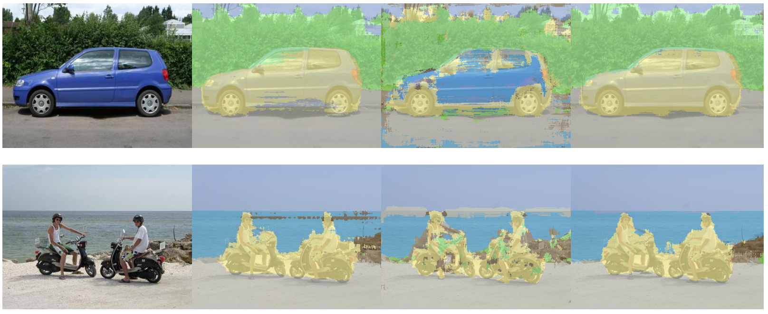
Semantic Segmentation: Refinement
Same CNN weights: recurrent convolutional network
Apply CNN once to get labels
Apply AGAIN to refine labels
And again!
More iterations improve results
Pinheiro and Collobert, “Recurrent Convolutional Neural Networks for Scene Labeling”, ICML 2014

Slide 41
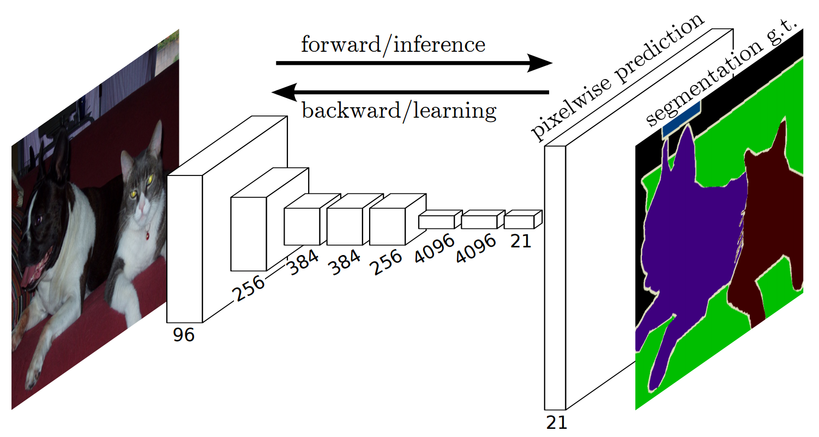
Semantic Segmentation: Upsampling
Long, Shelhamer, and Darrell, “Fully Convolutional Networks for Semantic Segmentation”, CVPR 2015

Slide 42
Semantic Segmentation: Upsampling
Learnable upsampling!
Long, Shelhamer, and Darrell, “Fully Convolutional Networks for Semantic Segmentation”, CVPR 2015

Slide 43
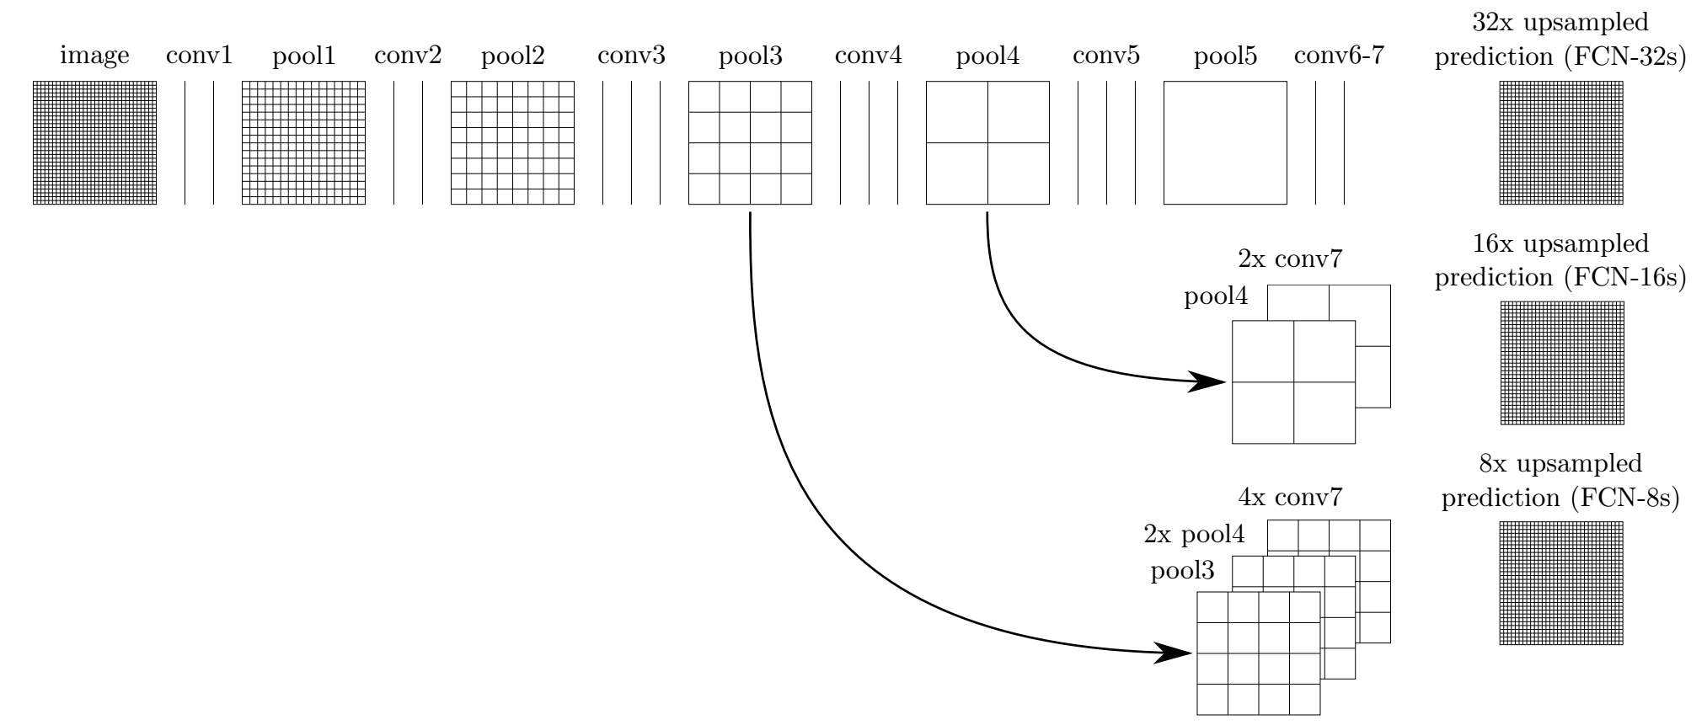
Semantic Segmentation: Upsampling
Long, Shelhamer, and Darrell, “Fully Convolutional Networks for Semantic Segmentation”, CVPR 2015

Slide 44
Semantic Segmentation: Upsampling
“skip connections”
Long, Shelhamer, and Darrell, “Fully Convolutional Networks for Semantic Segmentation”, CVPR 2015

Slide 45
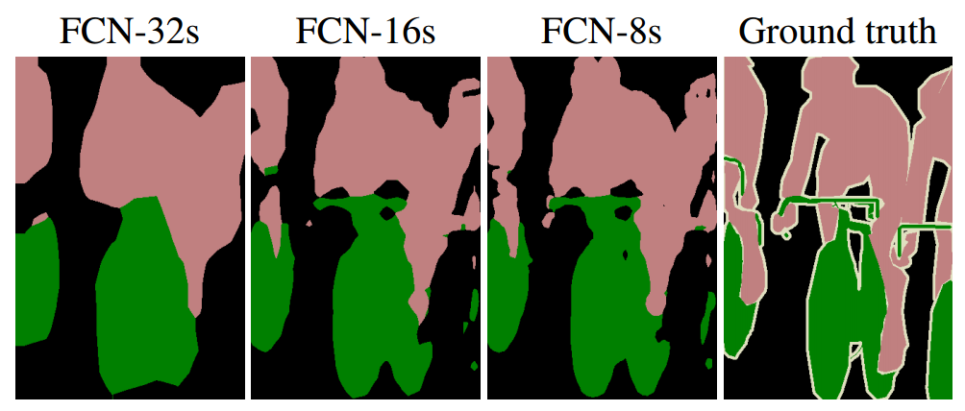
Semantic Segmentation: Upsampling
“skip connections”
Skip connections = Better results
Long, Shelhamer, and Darrell, “Fully Convolutional Networks for Semantic Segmentation”, CVPR 2015

Slide 46
Learnable Upsampling: “Deconvolution”
Typical 3 x 3 convolution, stride 1 pad 1
Input: 4 x 4
Output: 4 x 4

Slide 47
Learnable Upsampling: “Deconvolution”
Typical 3 x 3 convolution, stride 1 pad 1
Dot product between filter and input
Input: 4 x 4
Output: 4 x 4

Slide 48
Learnable Upsampling: “Deconvolution”
Typical 3 x 3 convolution, stride 1 pad 1
Dot product between filter and input
Input: 4 x 4
Output: 4 x 4

Slide 49
Learnable Upsampling: “Deconvolution”
Typical 3 x 3 convolution, stride 2 pad 1
Input: 4 x 4
Output: 2 x 2

Slide 50
Learnable Upsampling: “Deconvolution”
Typical 3 x 3 convolution, stride 2 pad 1
Dot product between filter and input
Input: 4 x 4
Output: 2 x 2

Slide 51
Learnable Upsampling: “Deconvolution”
Typical 3 x 3 convolution, stride 2 pad 1
Dot product between filter and input
Input: 4 x 4
Output: 2 x 2

Slide 52
Learnable Upsampling: “Deconvolution”
3 x 3 “deconvolution”, stride 2 pad 1
Input: 2 x 2
Output: 4 x 4

Slide 53
Learnable Upsampling: “Deconvolution”
3 x 3 “deconvolution”, stride 2 pad 1
Input gives weight for filter
Input: 2 x 2
Output: 4 x 4

Slide 54
Learnable Upsampling: “Deconvolution”
3 x 3 “deconvolution”, stride 2 pad 1
Input gives weight for filter
Input: 2 x 2
Output: 4 x 4

Slide 55
Learnable Upsampling: “Deconvolution”
3 x 3 “deconvolution”, stride 2 pad 1
Sum where output overlaps
Input gives weight for filter
Input: 2 x 2
Output: 4 x 4

Slide 56
Learnable Upsampling: “Deconvolution”
3 x 3 “deconvolution”, stride 2 pad 1
Sum where output overlaps
Same as backward pass for normal convolution!
Input gives weight for filter
Input: 2 x 2
Output: 4 x 4

Slide 57
Learnable Upsampling: “Deconvolution”
3 x 3 “deconvolution”, stride 2 pad 1
Sum where output overlaps
Same as backward pass for normal convolution!
“Deconvolution” is a bad name, already defined as “inverse of convolution”
Better names: convolution transpose,
backward strided convolution,
1/2 strided convolution, upconvolution
Input gives weight for filter
Input: 2 x 2
Output: 4 x 4

Slide 58
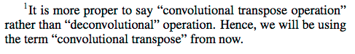
Learnable Upsampling: “Deconvolution”
“Deconvolution” is a bad name, already defined as “inverse of convolution”
Better names: convolution transpose,
backward strided convolution,
1/2 strided convolution, upconvolution
Im et al, “Generating images with recurrent adversarial networks”, arXiv 2016
Radford et al, “Unsupervised Representation Learning with Deep Convolutional Generative Adversarial Networks”, ICLR 2016

Slide 59
Learnable Upsampling: “Deconvolution”
Great explanation in appendix
“Deconvolution” is a bad name, already defined as “inverse of convolution”
Better names: convolution transpose,
backward strided convolution,
1/2 strided convolution, upconvolution
Im et al, “Generating images with recurrent adversarial networks”, arXiv 2016
Radford et al, “Unsupervised Representation Learning with Deep Convolutional Generative Adversarial Networks”, ICLR 2016

Slide 60
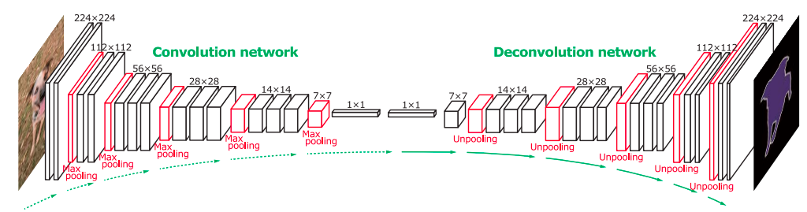
Semantic Segmentation: Upsampling
Noh et al, “Learning Deconvolution Network for Semantic Segmentation”, ICCV 2015

Slide 61
Semantic Segmentation: Upsampling
Normal VGG
“Upside down” VGG
Noh et al, “Learning Deconvolution Network for Semantic Segmentation”, ICCV 2015
6 days of training on Titan X…

Slide 62
Instance Segmentation

Slide 63
Instance Segmentation
Detect instances, give category, label pixels
“simultaneous detection and segmentation” (SDS)
Lots of recent work (MS-COCO)
Figure credit: Dai et al, “Instance-aware Semantic Segmentation via Multi-task Network Cascades”, arXiv 2015

Slide 64
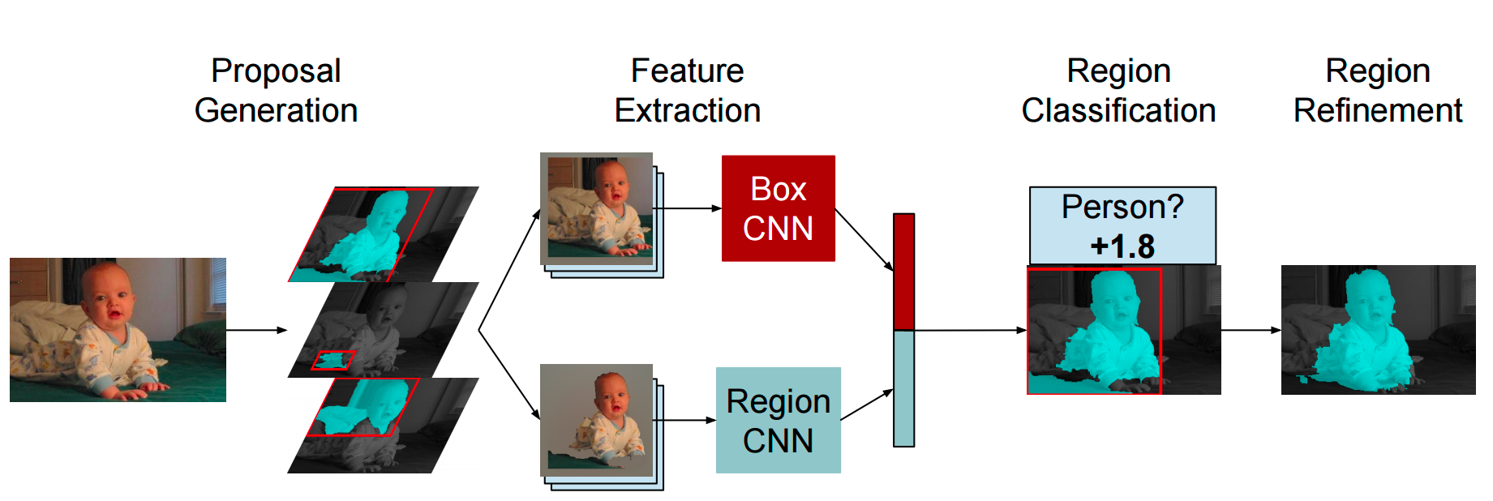
Instance Segmentation
Similar to R-CNN, but with segments
Hariharan et al, “Simultaneous Detection and Segmentation”, ECCV 2014

Slide 65
Instance Segmentation
Similar to R-CNN, but with segments
External Segment proposals
Hariharan et al, “Simultaneous Detection and Segmentation”, ECCV 2014

Slide 66
Instance Segmentation
Similar to R-CNN, but with segments
External Segment proposals
Hariharan et al, “Simultaneous Detection and Segmentation”, ECCV 2014

Slide 67
Instance Segmentation
Similar to R-CNN, but with segments
External Segment proposals
Mask out background with mean image
Hariharan et al, “Simultaneous Detection and Segmentation”, ECCV 2014

Slide 68
Instance Segmentation
Similar to R-CNN, but with segments
External Segment proposals
Mask out background with mean image
Hariharan et al, “Simultaneous Detection and Segmentation”, ECCV 2014

Slide 69
Instance Segmentation
Similar to R-CNN, but with segments
External Segment proposals
Mask out background with mean image
Hariharan et al, “Simultaneous Detection and Segmentation”, ECCV 2014

Slide 70
Instance Segmentation: Hypercolumns
Hariharan et al, “Hypercolumns for Object Segmentation and Fine-grained Localization”, CVPR 2015

Slide 71
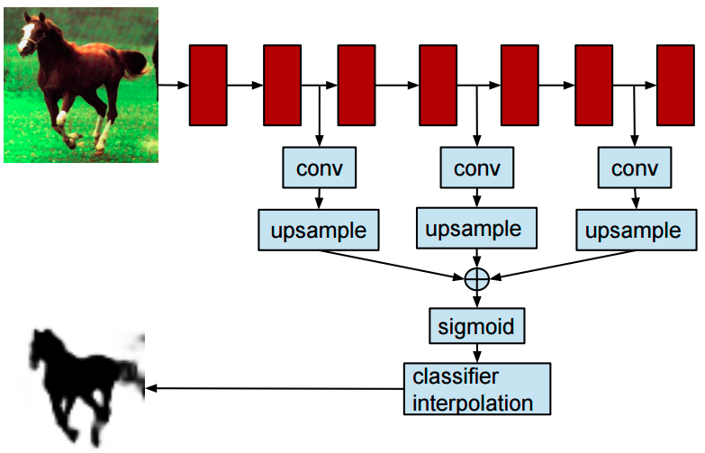
Instance Segmentation: Hypercolumns
Hariharan et al, “Hypercolumns for Object Segmentation and Fine-grained Localization”, CVPR 2015

Slide 72
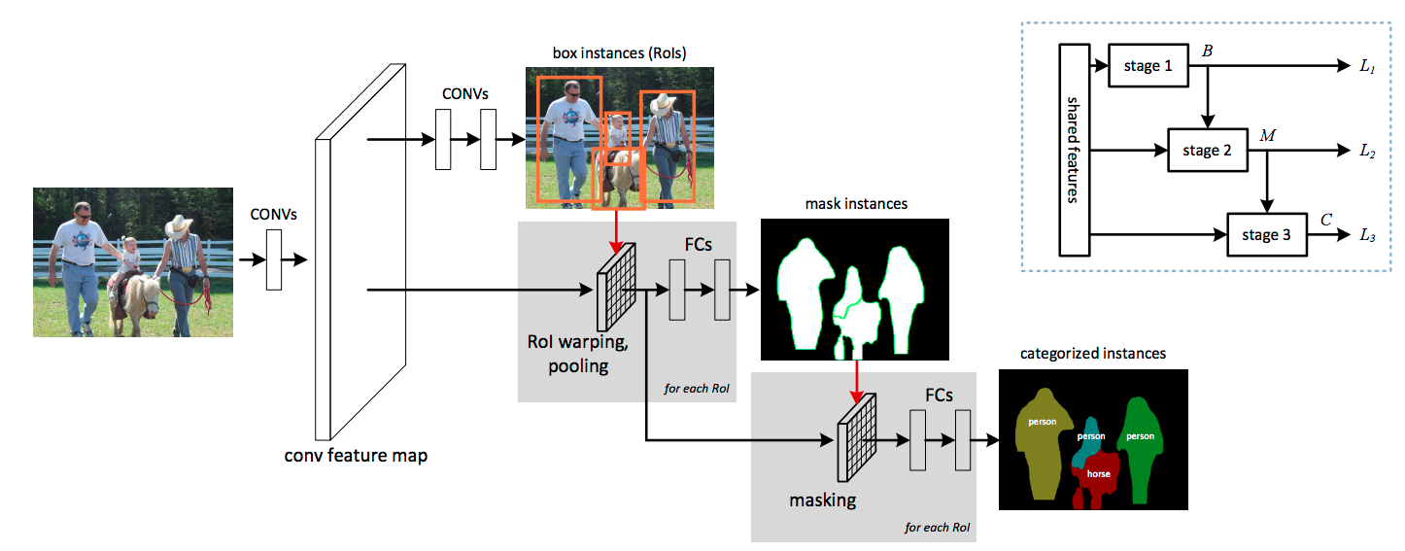
Instance Segmentation: Cascades
Similar to Faster R-CNN
Won COCO 2015 challenge (with ResNet)
Dai et al, “Instance-aware Semantic Segmentation via Multi-task Network Cascades”, arXiv 2015

Slide 73
Instance Segmentation: Cascades
Similar to Faster R-CNN
Won COCO 2015 challenge (with ResNet)
Dai et al, “Instance-aware Semantic Segmentation via Multi-task Network Cascades”, arXiv 2015

Slide 74
Instance Segmentation: Cascades
Similar to Faster R-CNN
Region proposal network (RPN)
Won COCO 2015 challenge (with ResNet)
Dai et al, “Instance-aware Semantic Segmentation via Multi-task Network Cascades”, arXiv 2015

Slide 75
Instance Segmentation: Cascades
Similar to Faster R-CNN
Region proposal network (RPN)
Reshape boxes to fixed size,
figure / ground logistic regression
Won COCO 2015 challenge (with ResNet)
Dai et al, “Instance-aware Semantic Segmentation via Multi-task Network Cascades”, arXiv 2015

Slide 76
Instance Segmentation: Cascades
Similar to Faster R-CNN
Region proposal network (RPN)
Reshape boxes to fixed size,
figure / ground logistic regression
Mask out background, predict object class
Won COCO 2015 challenge (with ResNet)
Dai et al, “Instance-aware Semantic Segmentation via Multi-task Network Cascades”, arXiv 2015

Slide 77
Instance Segmentation: Cascades
Similar to Faster R-CNN
Region proposal network (RPN)
Reshape boxes to fixed size,
figure / ground logistic regression
Learn entire model end-to-end!
Mask out background, predict object class
Won COCO 2015 challenge (with ResNet)
Dai et al, “Instance-aware Semantic Segmentation via Multi-task Network Cascades”, arXiv 2015

Slide 78
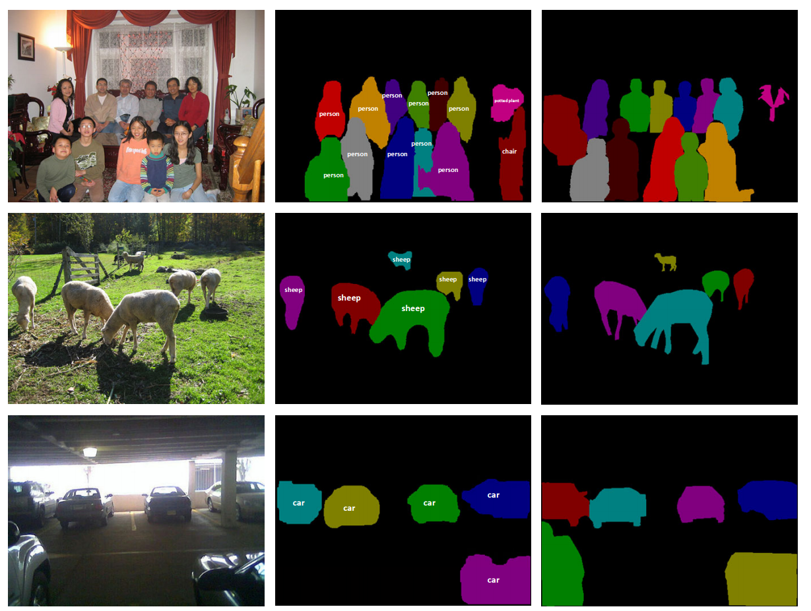
Instance Segmentation: Cascades
Dai et al, “Instance-aware Semantic Segmentation via Multi-task Network Cascades”, arXiv 2015
Predictions
Ground truth

Slide 79
Segmentation Overview
Semantic segmentation
Classify all pixels
Fully convolutional models, downsample then upsample
Learnable upsampling: fractionally strided convolution
Skip connections can help
Instance Segmentation
Detect instance, generate mask
Similar pipelines to object detection

Slide 80
Attention Models

Slide 81
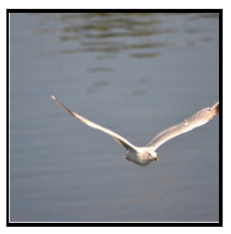
Recall: RNN for Captioning
Image: H x W x 3

Slide 82
Recall: RNN for Captioning
CNN
Image: H x W x 3
Features: D

Slide 83
Recall: RNN for Captioning
CNN
h0
Image: H x W x 3
Features: D
Hidden state: H

Slide 84
Recall: RNN for Captioning
Distribution over vocab
d1
CNN
h0
h1
Image: H x W x 3
Features: D
Hidden state: H
y1
First word

Slide 85
Recall: RNN for Captioning
Distribution over vocab
d1
d2
CNN
h0
h1
h2
Image: H x W x 3
Features: D
Hidden state: H
y1
y2
First word
Second word

Slide 86
Recall: RNN for Captioning
RNN only looks at whole image, once
Distribution over vocab
d1
d2
CNN
h0
h1
h2
Image: H x W x 3
Features: D
Hidden state: H
y1
y2
First word
Second word

Slide 87
Recall: RNN for Captioning
RNN only looks at whole image, once
Distribution over vocab
d1
d2
CNN
h0
h1
h2
Image: H x W x 3
Features: D
Hidden state: H
What if the RNN looks at different parts of the image at each timestep?
y1
y2
First word
Second word

Slide 88
Soft Attention for Captioning
CNN
Features: L x D
Image: H x W x 3
Xu et al, “Show, Attend and Tell: Neural Image Caption Generation with Visual Attention”, ICML 2015

Slide 89
Soft Attention for Captioning
CNN
h0
Features: L x D
Image: H x W x 3
Xu et al, “Show, Attend and Tell: Neural Image Caption Generation with Visual Attention”, ICML 2015

Slide 90
Soft Attention for Captioning
Distribution over L locations
a1
CNN
h0
Features: L x D
Image: H x W x 3
Xu et al, “Show, Attend and Tell: Neural Image Caption Generation with Visual Attention”, ICML 2015

Slide 91
Soft Attention for Captioning
Distribution over L locations
a1
CNN
h0
Features: L x D
Image: H x W x 3
Weighted features: D
z1
Weighted combination of features
Xu et al, “Show, Attend and Tell: Neural Image Caption Generation with Visual Attention”, ICML 2015

Slide 92
Soft Attention for Captioning
Distribution over L locations
a1
CNN
h0
h1
Features: L x D
Image: H x W x 3
Weighted features: D
z1
y1
Weighted combination of features
Xu et al, “Show, Attend and Tell: Neural Image Caption Generation with Visual Attention”, ICML 2015
First word

Slide 93
Soft Attention for Captioning
Distribution over L locations
Distribution over vocab
a1
a2
d1
CNN
h0
h1
Features: L x D
Image: H x W x 3
Weighted features: D
z1
y1
Weighted combination of features
Xu et al, “Show, Attend and Tell: Neural Image Caption Generation with Visual Attention”, ICML 2015
First word

Slide 94
Soft Attention for Captioning
Distribution over L locations
Distribution over vocab
a1
a2
d1
CNN
h0
h1
Features: L x D
Image: H x W x 3
Weighted features: D
z1
y1
z2
Weighted combination of features
Xu et al, “Show, Attend and Tell: Neural Image Caption Generation with Visual Attention”, ICML 2015
First word

Slide 95
Soft Attention for Captioning
Distribution over L locations
Distribution over vocab
a1
a2
d1
CNN
h0
h1
h2
Features: L x D
Image: H x W x 3
Weighted features: D
z1
y1
z2
y2
Weighted combination of features
Xu et al, “Show, Attend and Tell: Neural Image Caption Generation with Visual Attention”, ICML 2015
First word

Slide 96
Soft Attention for Captioning
Distribution over L locations
Distribution over vocab
a1
a2
d1
a3
d2
CNN
h0
h1
h2
Features: L x D
Image: H x W x 3
Weighted features: D
z1
y1
z2
y2
Weighted combination of features
Xu et al, “Show, Attend and Tell: Neural Image Caption Generation with Visual Attention”, ICML 2015
First word

Slide 97
Soft Attention for Captioning
Guess which framework was used to implement?
Distribution over L locations
Distribution over vocab
a1
a2
d1
a3
d2
CNN
h0
h1
h2
Features: L x D
Image: H x W x 3
Weighted features: D
z1
y1
z2
y2
Weighted combination of features
Xu et al, “Show, Attend and Tell: Neural Image Caption Generation with Visual Attention”, ICML 2015
First word

Slide 98
Soft Attention for Captioning
Guess which framework was used to implement?
Crazy RNN = Theano
Distribution over L locations
Distribution over vocab
a1
a2
d1
a3
d2
CNN
h0
h1
h2
Features: L x D
Image: H x W x 3
Weighted features: D
z1
y1
z2
y2
Weighted combination of features
Xu et al, “Show, Attend and Tell: Neural Image Caption Generation with Visual Attention”, ICML 2015
First word

Slide 99
Soft vs Hard Attention
a | b
c | d
CNN
Grid of features
(Each D-dimensional)
Image: H x W x 3
From RNN:
p_{a} | p_{b}
p_{c} | p_{d}
Distribution over grid locations p_{a} + p_{b} + p_{c} + p_{c} = 1
Xu et al, “Show, Attend and Tell: Neural Image Caption Generation with Visual Attention”, ICML 2015

Slide 100
Soft vs Hard Attention
a | b
c | d
CNN
Grid of features
(Each D-dimensional)
Image: H x W x 3
Context vector z (D-dimensional)
From RNN:
p_{a} | p_{b}
p_{c} | p_{d}
Distribution over grid locations p_{a} + p_{b} + p_{c} + p_{c} = 1
Xu et al, “Show, Attend and Tell: Neural Image Caption Generation with Visual Attention”, ICML 2015

Slide 101
Soft vs Hard Attention
Soft attention:
Summarize ALL locations z = p_{a}a+ p_{b}b + p_{c}c + p_{d}d
Derivative dz/dp is nice!
Train with gradient descent
a | b
c | d
CNN
Grid of features
(Each D-dimensional)
Image: H x W x 3
Context vector z (D-dimensional)
From RNN:
p_{a} | p_{b}
p_{c} | p_{d}
Distribution over grid locations p_{a} + p_{b} + p_{c} + p_{c} = 1
Xu et al, “Show, Attend and Tell: Neural Image Caption Generation with Visual Attention”, ICML 2015

Slide 102
Soft vs Hard Attention
Soft attention:
Summarize ALL locations z = p_{a}a+ p_{b}b + p_{c}c + p_{d}d
Derivative dz/dp is nice!
Train with gradient descent
a | b
c | d
CNN
Grid of features
(Each D-dimensional)
Image: H x W x 3
Context vector z (D-dimensional)
Hard attention: Sample ONE location according to p, z = that vector
With argmax, dz/dp is zero almost everywhere … Can’t use gradient descent; need reinforcement learning
From RNN:
p_{a} | p_{b}
p_{c} | p_{d}
Distribution over grid locations p_{a} + p_{b} + p_{c} + p_{c} = 1
Xu et al, “Show, Attend and Tell: Neural Image Caption Generation with Visual Attention”, ICML 2015

Slide 103
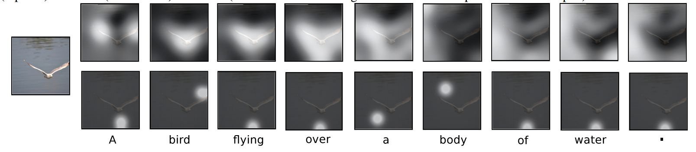
Soft Attention for Captioning
Soft attention
Hard attention
Xu et al, “Show, Attend and Tell: Neural Image Caption Generation with Visual Attention”, ICML 2015

Slide 104
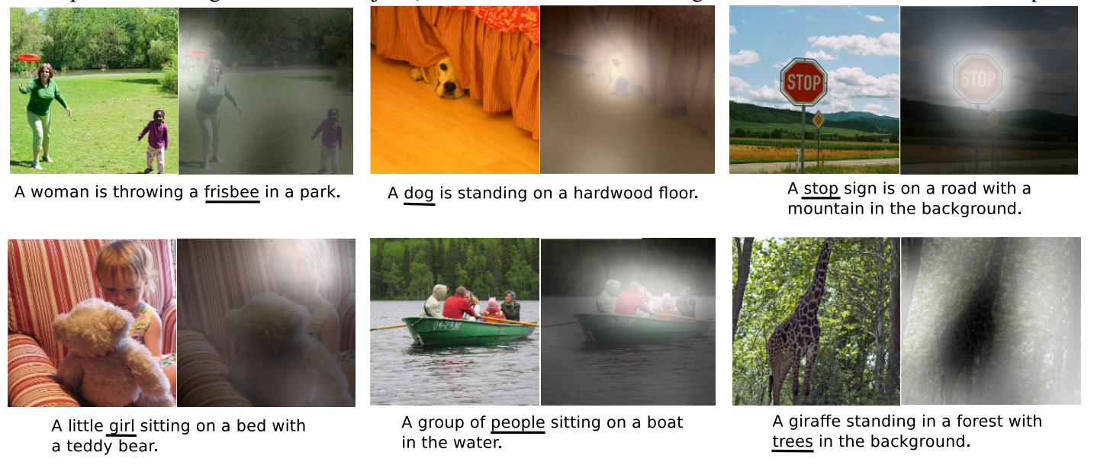
Soft Attention for Captioning
Xu et al, “Show, Attend and Tell: Neural Image Caption Generation with Visual Attention”, ICML 2015

Slide 105
Soft Attention for Captioning
Attention constrained to fixed grid! We’ll come back to this ….
Xu et al, “Show, Attend and Tell: Neural Image Caption Generation with Visual Attention”, ICML 2015

Slide 106

Soft Attention for Translation
“Mi gato es el mejor” -> “My cat is the best”
Bahdanau et al, “Neural Machine Translation by Jointly Learning to Align and Translate”, ICLR 2015

Slide 107
Soft Attention for Translation
Distribution over input words
“Mi gato es el mejor” -> “My cat is the best”
Bahdanau et al, “Neural Machine Translation by Jointly Learning to Align and Translate”, ICLR 2015

Slide 108
Soft Attention for Translation
Distribution over input words
“Mi gato es el mejor” -> “My cat is the best”
Bahdanau et al, “Neural Machine Translation by Jointly Learning to Align and Translate”, ICLR 2015

Slide 109
Soft Attention for Translation
Distribution over input words
“Mi gato es el mejor” -> “My cat is the best”
Bahdanau et al, “Neural Machine Translation by Jointly Learning to Align and Translate”, ICLR 2015

Slide 110
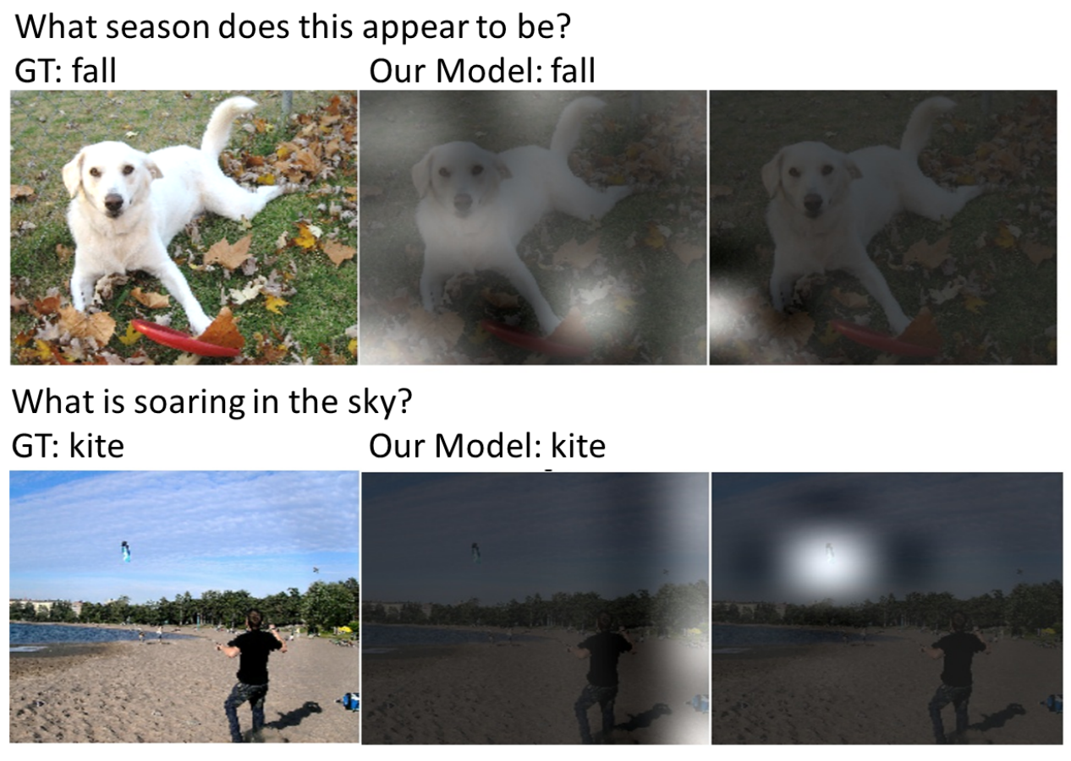
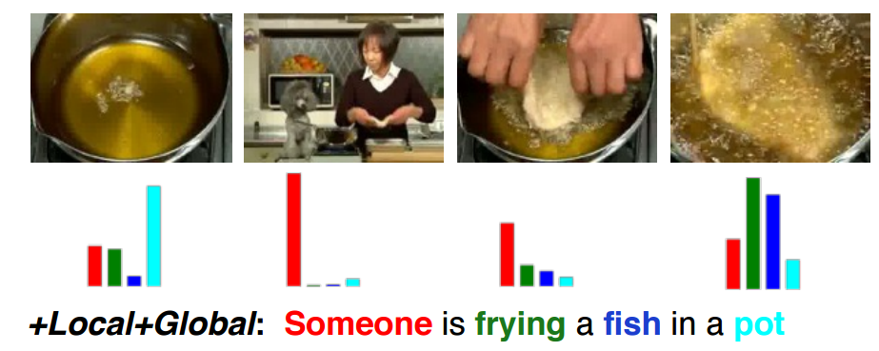
Soft Attention for Everything!
Machine Translation, attention over input:
- Luong et al, “Effective Approaches to Attention-based Neural Machine Translation,” EMNLP 2015
Video captioning,
attention over input frames:
- Yao et al, “Describing Videos by Exploiting Temporal Structure”, ICCV 2015
Image, question to answer, attention over image:
- Xu and Saenko, “Ask, Attend and Answer: Exploring Question-Guided Spatial Attention for Visual Question Answering”, arXiv 2015
- Zhu et al, “Visual7W: Grounded Question Answering in Images”, arXiv 2015
Speech recognition, attention over input sounds:
- Chan et al, “Listen, Attend, and Spell”, arXiv 2015
- Chorowski et al, “Attention-based models for Speech Recognition”, NIPS 2015

Slide 111
Attending to arbitrary regions?
Features: L x D
Image: H x W x 3
Attention mechanism from Show, Attend, and Tell only lets us softly attend to fixed grid positions … can we do better?

Slide 112
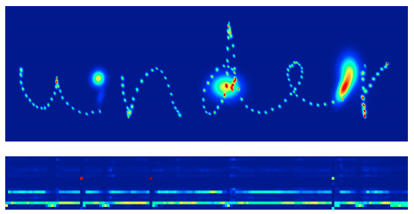
Attending to Arbitrary Regions
- Read text, generate handwriting using an RNN
- Attend to arbitrary regions of the output by predicting params of a mixture model
Graves, “Generating Sequences with Recurrent Neural Networks”, arXiv 2013

Slide 113
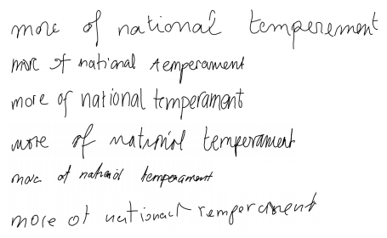
Attending to Arbitrary Regions
- Read text, generate handwriting using an RNN
- Attend to arbitrary regions of the output by predicting params of a mixture model
Which are real and which are generated?
Graves, “Generating Sequences with Recurrent Neural Networks”, arXiv 2013

Slide 114
Attending to Arbitrary Regions
- Read text, generate handwriting using an RNN
- Attend to arbitrary regions of the output by predicting params of a mixture model
Which are real and which are generated?
REAL
Graves, “Generating Sequences with Recurrent Neural Networks”, arXiv 2013
GENERATED

Slide 115
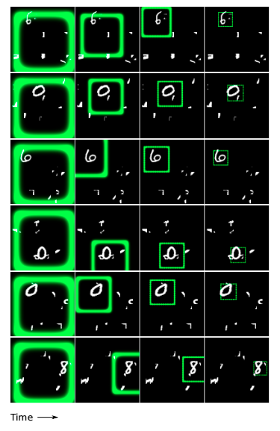
Attending to Arbitrary Regions: DRAW
Classify images by attending to arbitrary regions of the input
Gregor et al, “DRAW: A Recurrent Neural Network For Image Generation”, ICML 2015

Slide 116
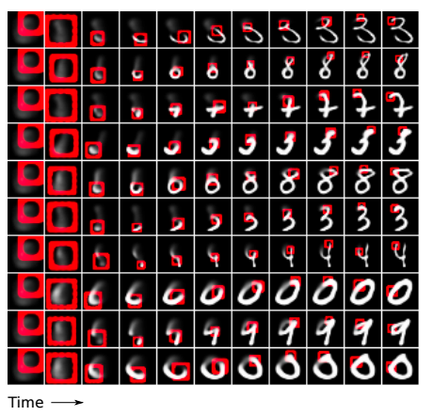
Attending to Arbitrary Regions: DRAW
Classify images by attending to arbitrary regions of the input
Generate images by attending to arbitrary regions of the output
Gregor et al, “DRAW: A Recurrent Neural Network For Image Generation”, ICML 2015

Slide 117
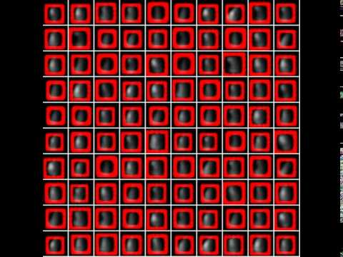

Slide 118
Attending to Arbitrary Regions: Spatial Transformer Networks
Attention mechanism similar to DRAW, but easier to explain
Jaderberg et al, “Spatial Transformer Networks”, NIPS 2015

Slide 119
Spatial Transformer Networks
Input image:
H x W x 3
Cropped and rescaled image:
X x Y x 3
Box Coordinates:
(xc, yc, w, h)
Jaderberg et al, “Spatial Transformer Networks”, NIPS 2015

Slide 120
Spatial Transformer Networks
Can we make this function differentiable?
Input image:
H x W x 3
Cropped and rescaled image:
X x Y x 3
Box Coordinates:
(xc, yc, w, h)
Jaderberg et al, “Spatial Transformer Networks”, NIPS 2015

Slide 121
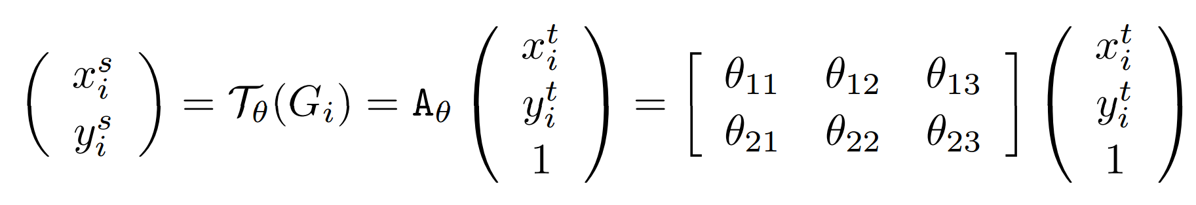
Spatial Transformer Networks
Idea: Function mapping pixel coordinates (xt, yt) of output to pixel coordinates (xs, ys) of input
Can we make this function differentiable?
Input image:
H x W x 3
Cropped and rescaled image:
X x Y x 3
Box Coordinates:
(xc, yc, w, h)
Jaderberg et al, “Spatial Transformer Networks”, NIPS 2015

Slide 122
Spatial Transformer Networks
Idea: Function mapping pixel coordinates (xt, yt) of output to pixel coordinates (xs, ys) of input
(x^{s}, y^{s})
Can we make this function differentiable?
(x^{t}, y^{t})
Input image:
H x W x 3
Cropped and rescaled image:
X x Y x 3
Box Coordinates:
(xc, yc, w, h)
Jaderberg et al, “Spatial Transformer Networks”, NIPS 2015

Slide 123
Spatial Transformer Networks
Idea: Function mapping pixel coordinates (xt, yt) of output to pixel coordinates (xs, ys) of input
(x^{s}, y^{s})
Can we make this function differentiable?
(x^{t}, y^{t})
Input image:
H x W x 3
Cropped and rescaled image:
X x Y x 3
Box Coordinates:
(xc, yc, w, h)
Jaderberg et al, “Spatial Transformer Networks”, NIPS 2015

Slide 124
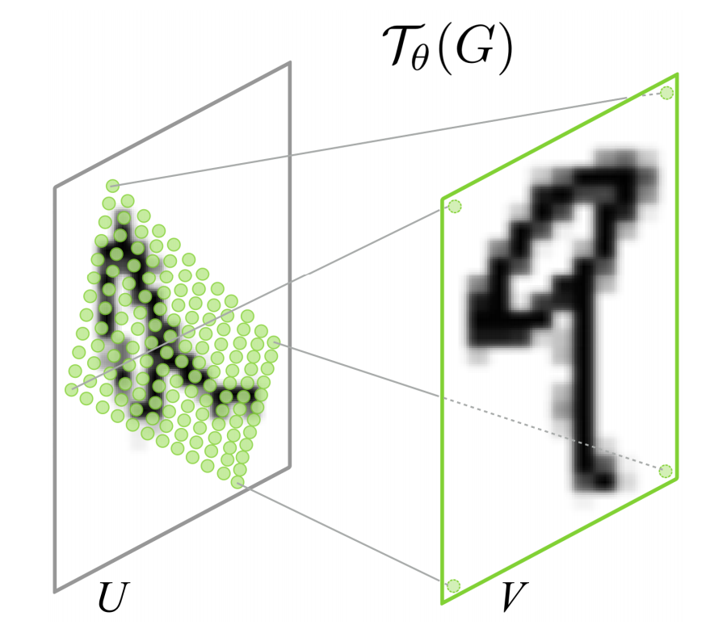
Spatial Transformer Networks
Idea: Function mapping pixel coordinates (xt, yt) of output to pixel coordinates (xs, ys) of input
Can we make this function differentiable?
Input image:
H x W x 3
Repeat for all pixels in output to get a sampling grid
Cropped and rescaled image:
X x Y x 3
Box Coordinates:
(xc, yc, w, h)
Jaderberg et al, “Spatial Transformer Networks”, NIPS 2015

Slide 125
Spatial Transformer Networks
Idea: Function mapping pixel coordinates (xt, yt) of output to pixel coordinates (xs, ys) of input
Can we make this function differentiable?
Input image:
H x W x 3
Repeat for all pixels in output to get a sampling grid
Then use bilinear interpolation to compute output
Cropped and rescaled image:
X x Y x 3
Box Coordinates:
(xc, yc, w, h)
Jaderberg et al, “Spatial Transformer Networks”, NIPS 2015

Slide 126
Spatial Transformer Networks
Idea: Function mapping pixel coordinates (xt, yt) of output to pixel coordinates (xs, ys) of input
Network attends to input by predicting 𝜃
Can we make this function differentiable?
Input image:
H x W x 3
Repeat for all pixels in output to get a sampling grid
Then use bilinear interpolation to compute output
Cropped and rescaled image:
X x Y x 3
Box Coordinates:
(xc, yc, w, h)
Jaderberg et al, “Spatial Transformer Networks”, NIPS 2015

Slide 127
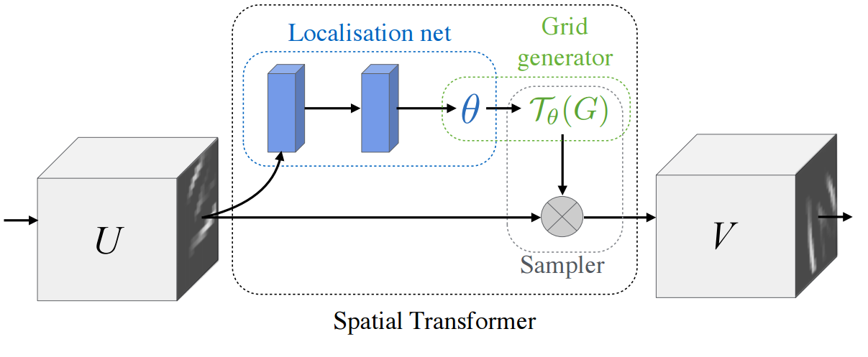
Spatial Transformer Networks
Input: Full image
Output: Region of interest from input

Slide 128
Spatial Transformer Networks
A small Localization network predicts transform 𝜃
Input: Full image
Output: Region of interest from input

Slide 129
Spatial Transformer Networks
Grid generator uses 𝜃 to compute sampling grid
A small Localization network predicts transform 𝜃
Input: Full image
Output: Region of interest from input

Slide 130
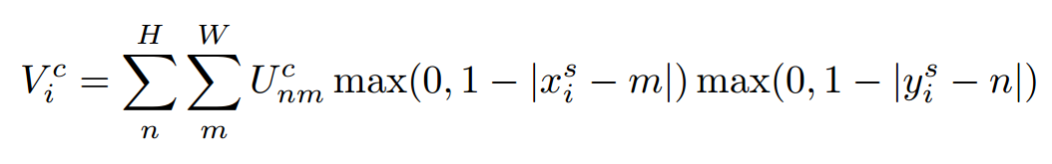
Spatial Transformer Networks
Grid generator uses 𝜃 to compute sampling grid
A small Localization network predicts transform 𝜃
Input: Full image
Output: Region of interest from input
Sampler uses bilinear interpolation to produce output

Slide 131

Spatial Transformer Networks
Insert spatial transformers into a classification network and it learns to attend and transform the input
Differentiable “attention / transformation” module

Slide 132


Slide 133
Attention Recap
Soft attention:
Easy to implement: produce distribution over input locations, reweight features and feed as input
Attend to arbitrary input locations using spatial transformer networks
Hard attention:
Attend to a single input location
Can’t use gradient descent!
Need reinforcement learning!

